Slide 1
HIGH PRIORITY PROJECTS IN ULAANBAATAR CITY
Groundwater Model
Green Land
Ulaanbaatar City Mayor’s Office
Ulaanbaatar, October 18, 2012

Slide 2
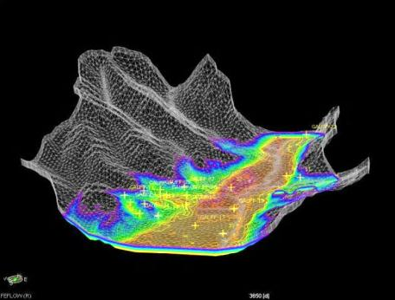
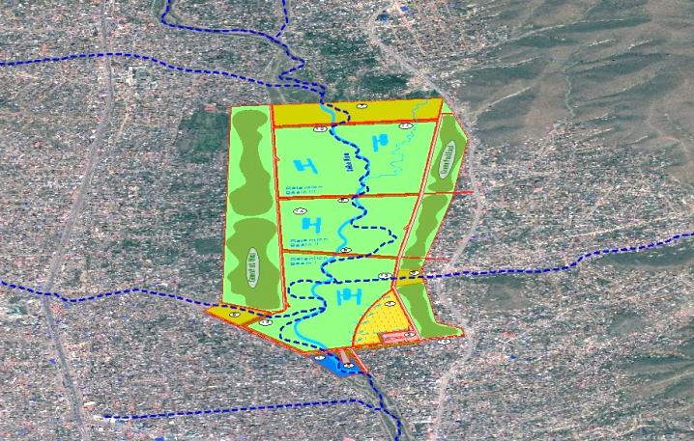
1. FEASIBILITY STUDY ON UTILIZATION
OF GROUND WATER AROUND ULAANBAATAR /70 mln US dollar/
Groundwater Model
Green Land

Slide 3
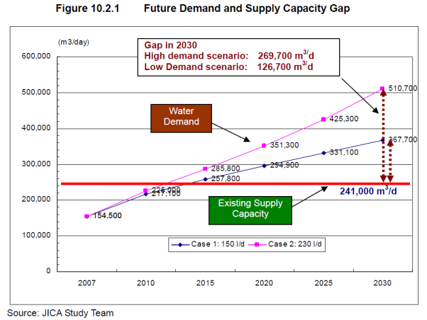
CURRENT GROUND WATER SITUATION IN ULAANBAATAR

Slide 4
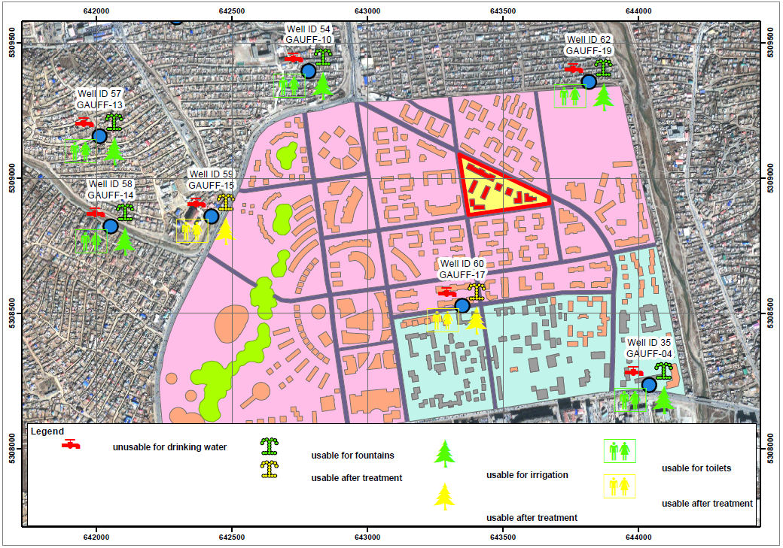
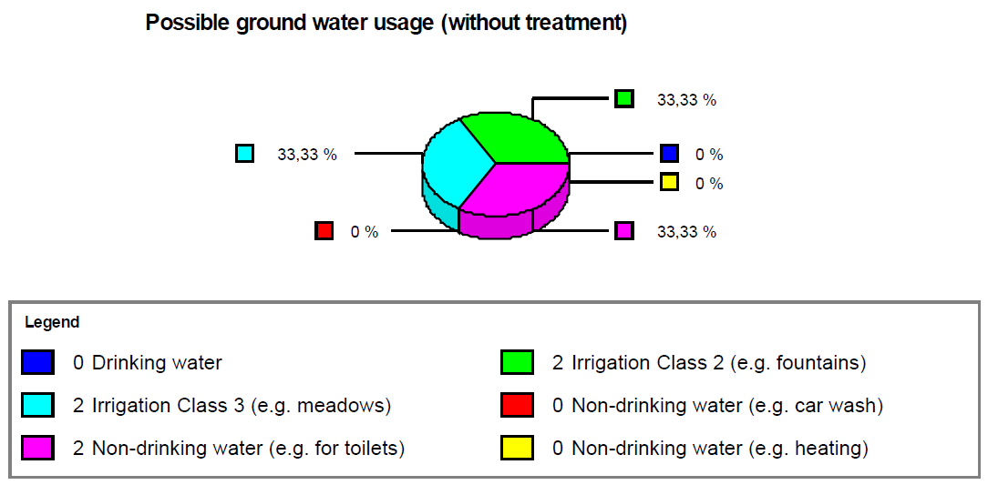
CURRENT GROUND WATER SITUATION IN ULAANBAATAR
Overview water use map Khoroolol 07

Slide 5
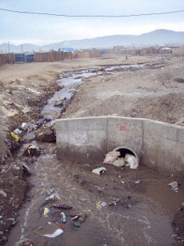
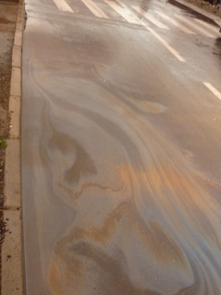
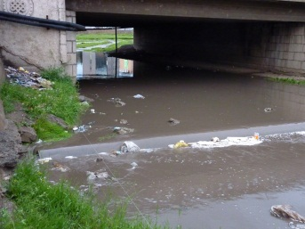
CURRENT GROUND WATER SITUATION IN ULAANBAATAR
Due to the fast growing city further problematic spots occur, which contaminate rivers and ground water.
Contaminated surface water flows into the river
The discharge of surface water on rain fall events dissipates the waste from the settlement areas.
Contaminated rain and river water drains away into the ground water!

Slide 6
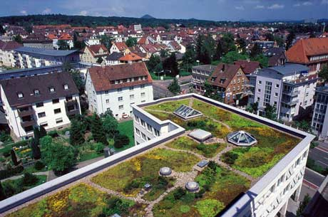
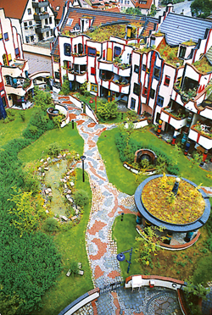
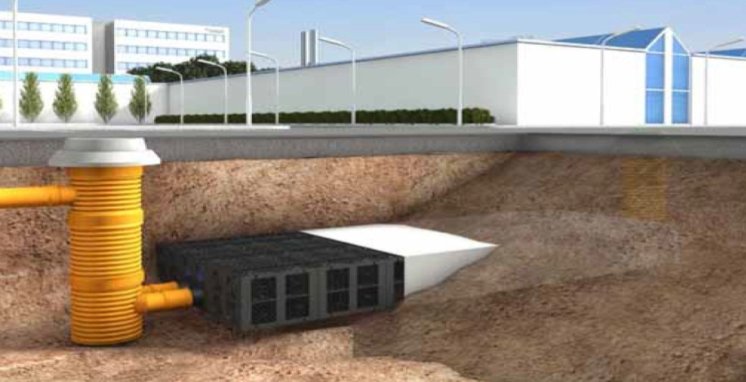
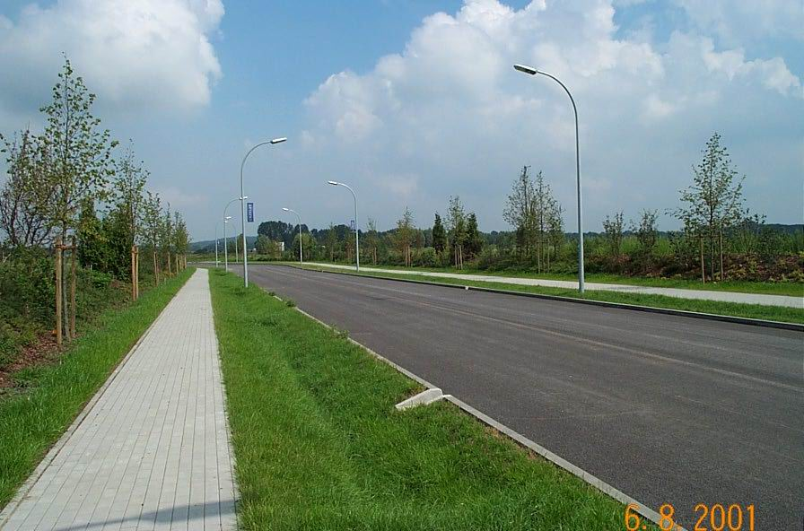
MEASURES – RAIN WATER UTILIZATION
Major results of the engineering findings based on detail investigation, study and analysis
Collection by green roofs
Drain-Box-System

Slide 7
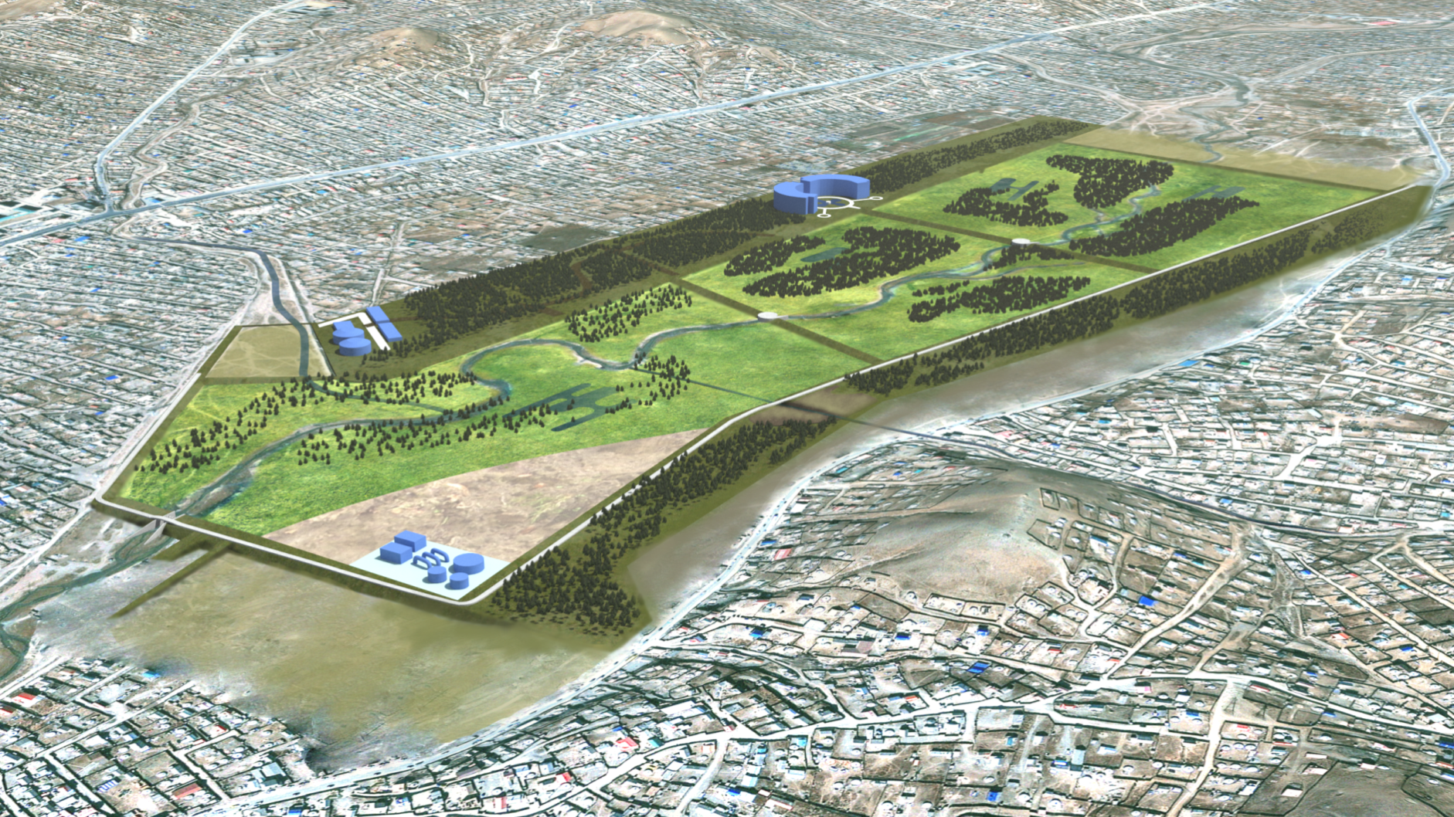
MEASURES – GREEN LAND – SELBE RIVER
Multi functional and long term water management solution
Collection by green roofs
Flood Retention basin: 1.2 Mio m³
Implementation time: 5 years
Appr. Investment costs: 60 to 80 Mio USD

Slide 8
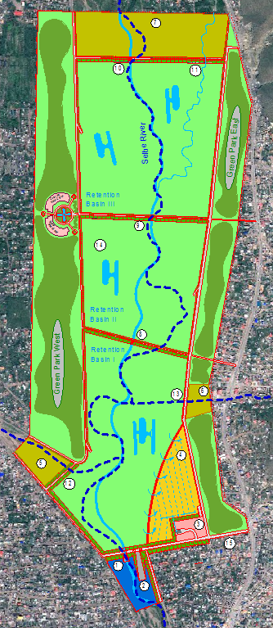
MEASURES – GREEN LAND – SELBE RIVER
The flood retention basin is located near the center
Retention
Basin III
It is situated in the north of the development area in Khoroolol 07
The volume of the basin is amounting to 1.2 Mio m³
It consists of 3 seperate retention basins
Retention
Basin II
It has several functions :
1. Retention basin on flood events!
2. Improvement of discharge in the Selbe River
3. Improvement of the local climate!
Retention
Basin I
4. Improvement of air streams in the city center!
5. Waste from the catchment areas will be
retained in a controlled manner!
6. It will be used for the recovery of drinking water!
7. It will serve as a generator for energy!
8. It will form a local recreation area for families!
Green Land
9. Development of a hotel and water congress complex

Slide 9
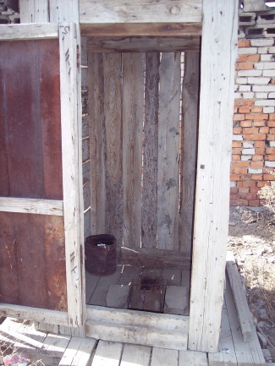
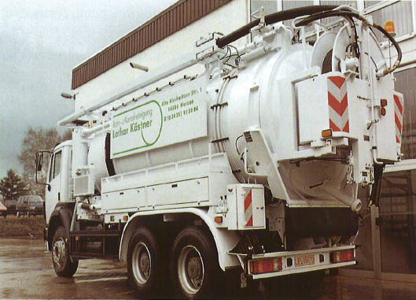
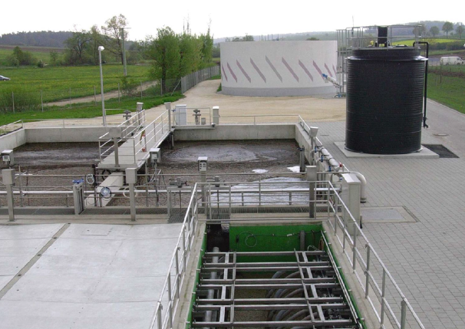
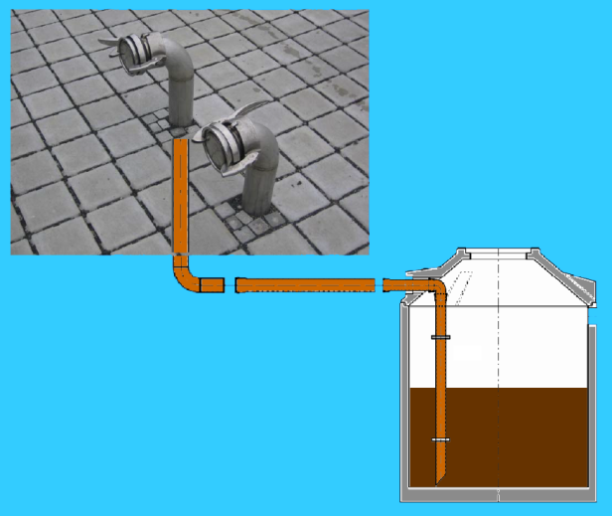
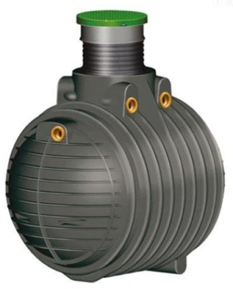
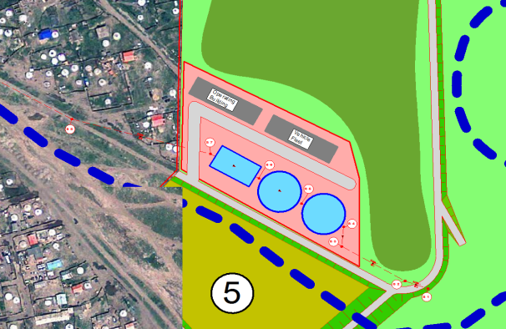
MEASURES – DECENTRALIZED WASTE WATER TREATMENT
Major results of the engineering findings based on detail investigation, study and analysis are summarized as under:
Reduction of soil and ground water infiltration
collection tanks
suction-pressure-tank vehicle
treatment plant

Slide 10
MEASURES – DECENTRALIZED WASTE WATER TREATMENT
Estimation of Capacities for Pilot Project Area :
General Basis
size of project area: ~ 100 ha
Number of households: ~ 1.500
Number of : 6 (1 family)
Caculation for suction-pressure-tank vehicle
one vehicle: 10.000 Litres
one truckload: 5 tanks
2 tours per vehicle and per day are possible.
Approximately 8 suction-pressure-tank vehicle are needed!
1 vehicle 875.000.000 MNT
8 vehicle 7.000.000.000 MNT
costs employees each year ~ 403.200.000 MNT
Calculation for collection tanks
volume of one tank 2.000 Litres
amount for 100 ha ~ 1.500
(costs for 1 tank 3.062.500 MNT)
costs for all tanks 4.593.750.000 MNT
(costs for service each plot 1.312.500 MNT)
costs for all plots 1.968.750.000 MNT
total 6.562.500.000 MNT

Slide 11
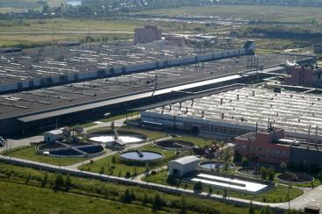
2. TECHNICAL AND ECONOMIC SUBSTANTIATION OF EFFLUENT TREATMENT PLANT OF TANNERY WHICH IS BEING BUILT IN THE NEW INHABITAD ZONA OF ULAANBAATAR CITY /250 mln Euro/

Slide 12
Development program of Ulaanbaatar area (2005-2015).
Perspective 1: to become the globally recognized, highly developed capital city and the international business center with strong economy and high level of the information, education and technology.
Perspective 2: to have the proper policy of the urban construction and land organization to provide with the infrastructure and to improve the residential condition of citizens.
Perspective 3: to become the progressive, legal city forming the healthy, safe environment and developing the social wealth.
Perspective 4: to become the efficient city with state management reporting the result of the works to the public, allowing the public participation and private enterprises to participate in the state service.
Perspective 5: to become the central city of tourism in the region of Asia.

Slide 14
BRIEF INTRODUCTION OF EFFLUENT TREATMENT PLANT OF TANNERY WHICH IS BEING BUILT IN THE NEW SETTLEMENT REGION OF ULAANBAATAR CITY
Purpose of treatment plant:
To treat the wastewater from effluent treatment plant of tanneries, units of Industrial Technology Park and apartments and public services in the new inhabited zona of Ulaanbaatar.
Reuse the treated water for technological application of tanneries
Location of pre-treatment plant:
Approximately 40 km from Ulaanbaatar, is located in the 20th khoroo of Songinokhairkhan district, the South part of former “Khurgani farmer”.
The selected locatioin is 10 km from “Emeelt market”.
The basin of Tuul river is 5 km.
The capacity of Industrial Technology Park and its tannery:
Capacity per year:
Hides of big cattle 930.0 thousand
Skin of small catlle 5 747.0 thousand
Total 6 677.0 thousand
Processing level:
The hide and skins are processed by complete cycle and produced final productions as boot, leather clothes and leather items.

Slide 15
The capacity of pre-treatment plant:
For processing raw hides:
For processing 1 kg raw hides it requires 50 litre water.
Avarage weight of raw hide is 17 kg.
Avarage working days for year are 250 days.
The wastewater volume is treated per day = 930 000 ш : 250 days х 17kg х 50 litre
= 3 162 000 litre = 3162 м³
For processing raw skins:
For processing 1 kg raw hides it requires 0,3 м³ water.
Avarege working days for year are 250 days.
The volume is treated per day is 5 747 000 : 250 days х 0.3 м³= 6897 м³
The wastewater volume is treated per day is = 3162 м³ + 6897 м³ + 941 м³ (domestic and other wastewater) = 11 000 м³

Slide 16
The capacity of pre-treatment plant:
Infrastructure:
Electricity supply – The electrical line network is established. It requires to built a sub-station. Before building it needs to calculate the required electricity of IT park.
Pure water – The ground water is used. By conducting survey dipping 100 m and can find the sorce of pure water.
Heating supply– Before built new station it needs to calculate the required electricity and heating of IT park.
Steam turbine - The technological steam is being used for tanneries so before building steam turbine requires to calculate whole demand of pure water for IT Park.
Railway – There is a plan to built 10 km railway from “Emeelt station” and discussed about connection of main road through Khushigtiin khundii of Tuv aimag.
Road – There is paved road is used now. Futuremore, need to improve ground road about 10 km.
Communication network – The old communication network is working there and need to maintaince.
Flooding dam – Now there is a gravet dam. There is a great need to built new well-built dam.
Labour force:
There will be work 60 workers.
At Industrial Technology Park of tannery will work about 13000 employers.
Social issues of employers:
In complaince with built an Industrial Technology Park of tannery at new inhabited zona will be built apartments, a hospital, a kindergarten, a schoo, a hotel, stores, and banks.

Slide 17
Ecology and social effect:
Constructing new treatment plant is created a possibility for tackling an urgent environmental and ecological problems of Ulaanbaatar city. Considering the economical evaluation of the ecological positive effect resulted from the construction of the new plant, the actual benefit of this project will be possible to increase. Also the stable operation of the skin and hide plants will be provided and the economical result of the activities operated under the form of the Industrial Technological Park should be accounted completely. The results of some estimation on this line done in the scope of the project team should be overseen. In the case that the plants have operated constantly, the socio economic positive effect has been appeared as employing at least 13000 employees.
The commission and utilization of the new plants will create a possibility to operate Pre-treatment plant located in Khan Uul district as a procedure of the domestic waste water treatment and thus it will reduce the current overload of the central refinery plant of Ulaanbaatar city and have an opportunity to operate under the normal procedure. It will reduce the contamination of Tuul river and improve the natural and ecological condition.

Slide 18
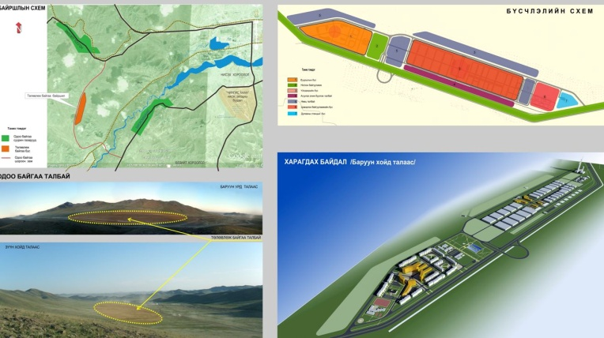
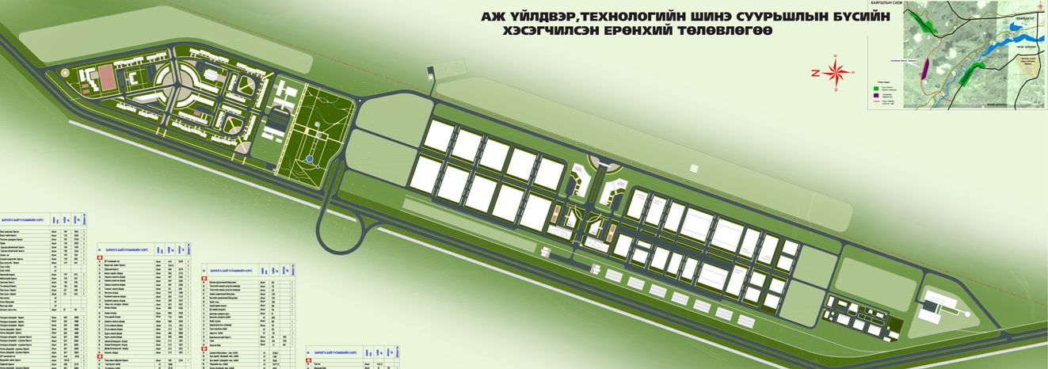
3. TECHNICAL AND ECONOMICAL SUBSTANTIATION OF THE “BAGANUUR” INDUSTRIAL & TECHNOLOGICAL PARK /15 mln US dollar/
Groundwater Model
Green Land

Slide 19
The legal basis, concept and principles of establishing the “Baganuur” ITP
The following legal documents constitute the framework within which the technical and economic feasibility study of the “Baganuur” ITP has been developed:
1) The Comprehensive National Development Strategy based on Mongolia Millennium development goals (NDS). This document has been approved by the Parliament resolution No.12 dated 31 January 2008.
2) The Guidelines on establishment and development of industrial & technological parks. This document has been approved by the Resolution No. 54 from 2003.
3) Development program for the Eastern region. This document has been approved by the Government resolution No. 202 from 2005.
4) Development program for the Ulaanbaatar region. This document was approved by the Government resolution No. 197 dated 16 August, 2006.
5) The Law on Free Economic Zones of 2002.

Slide 20
Concept and Principles
The Comprehensive National Development Strategy identifies the following 6 priority areas for development of Mongolia until 2021:
1) Implement Millennium Development Goals and develop Mongolians in all aspects
2) Establish an export-oriented, private sector led, stable and knowledge-based economy intensively developing industries and services based on high technology, including ICT, bio- and nanotechnology, transit transportation, logistics, financial intermediation, mining and deep-processing of agricultural products.
3) Accumulate wealth by exploiting strategic mineral deposits, ensure fast-paced economic development and high growth and develop modern processing industries.
4) Reduce rural-urban divide in terms of development by intensively developing regions and infrastructure
5) Create a sustainable environment for development through acquiring skills and building capacity for adaptation to the climate change, removing imbalance in ecosystem and protecting the environment.
6) Further improve the democratic political system towards creation of a transparent, responsible and fair system free of corruption and bureaucracy.

Slide 21
The activities of “Baganuur” ITP
Basing on the above identified principal activities of “Baganuur” ITP, the following factories have been chosen to be included in the ITP:
1. Nanobiotechnology experimental production centre
2. Meat processing factory
3. Milk and dairy product factory
4. Factories based on Baganuur mine:
Purified iron factory
Coal enrichment factory
Humified fertiliser factory
Lightweight block factory
Gravel factory
Treeplanting facility
Water purification factory
Biological revitalisation project
Tourist camp

Slide 22
Location of “Baganuur” ITP
“Baganuur” ITP will have 2 zones, with the 1st zone located in the industrial district on Baganuur, and the 2nd zone will be located adjacent to Baganuur mine.
Organisational structure of “Baganuur” ITP
The administration of “Baganuur” ITP will have its managing and audit boards, and the park governor will be appointed by the managing board. The managing board will consist of 11 members and the audit board will have 3 members. The park administration will have 2 departments: administrative and financial, with 41 employees in total and its salary expenses will be 144 720 000 tugrug and its administrative expenses will be 240 000 000 tugrug; totalling 384 720 000 tugrug of expense budget per annum.

Slide 23
Information on investment, costs, profits and financing
The nanobiotechnology experimental production centre would need approximately 18 million USD of investment. The nanobiotechnology experimental production centre will work with a total net profit of 20 033 536 000 tugrug.
The total investment cost for the meat processing factory is estimated to be 2.1 billion tugrug in total. For the establishment of the meat processing factory, a loan of 9.5 billion tugrug at 4% per annum for 10 years is necessary and own investment of 630 million tugrug will be made. The profit of the factory is expected to be 5.1 billion tugrug.
For the purposes of the factory building and equipment of the milk and dairy product factory, an investment of 489 million tugrug is necessary. 400 million tugrug loans will be made to be repaid within 6 years. The profit throughout the project period is estimated to be 2 092 624 206 tugrug.
The coal enrichment factory needs 15.2 billion tugrug of investment and this includes factory building and equipment-related issues. It is reflected to solve the financing issue with a privileged loan at 4% per annum which will be repaid in 8 years. This factory will work with an average annual profit of 9.2 billion tugrug.

Slide 24
Information on investment, costs, profits and financing
The purified iron factory needs 62.4 billion tugrug financing and this amount covers the factory building, equipment and other issues. It is reflected to solve the financing issue with a privileged loan at 4% per annum which will be repaid in 2.3 years. This factory will work with an average annual profit of 29.1 billion tugrug.
The gravel factory needs 591.2 million tugrug financing and this amount covers the factory building, equipment and other issues. It is reflected to solve the financing issue with a privileged loan at 4% per annum which will be repaid in 6.8 years. This factory will work with an average annual profit of 108.8 million tugrugs.
The humified fertiliser factory needs 855 million tugrug financing and this amount covers the factory building, equipment and other issues. It is reflected to solve the financing issue with a privileged loan at 4% per annum which will be repaid in 5 years. This factory will work with an average annual profit of 888.8 million tugrugs.

Slide 25
Investment, costs, profits and financing of the industries of the “Baganuur” ITP
№ | Indicators | Park 1 | Park 2 | Total amount (Tugrug) | Total amount (USD)
1 | Sales income | 106,266,145,400 | 535,121,746,794 | 641,387,892,194 | 549,133,469
2 | Own investment | 1,763,192,000 | 163,337,000 | 1,926,529,000 | 1,649,426
3 | Borrowing | 31,508,000,000 | 80,312,353,360 | 111,820,353,360 | 95,736,604
4 | Total expenditures | 33,271,192,000 | 80,475,690,360 | 113,746,882,360 | 97,386,029
5 | Loan repayments | 88,701,576,628 | 425,431,627,360 | 514,133,203,988 | 440,182,538
6 | Loan interest | 27,085,572,585 | 80,311,853,360 | 107,397,425,945 | 91,949,851
7 | Loan principal | 7,846,238,201 | 4,771,295,262 | 12,617,533,464 | 10,802,683
8 | Profit before tax | 3,113,552,622 |  | 3,113,552,622 | 2,665,713
9 | Tax | 67,466,535,339 | 107,390,315,898 | 174,856,851,236 | 149,706,208
10 | Net Profit | 19,491,425,790 | 10,739,031,590 | 30,230,457,380 | 25,882,241
 |  | 27,208,694,995 | 83,981,082,266 | 111,189,777,260 | 95,196,727

Slide 26
Thank you for your Attention

